Slide 1
Supervised Learning
Classification Project:
AllLife Bank Personal Loan Campaign
July 20, 2023
- Vaibhav Pradhan

Slide 2
Contents / Agenda
Executive Summary
Business Problem Overview and Solution Approach
EDA Results
Data Preprocessing
Model Performance Summary
Appendix

Slide 3
Executive Summary
Customer data from AllLife Bank was analysed and Logistic Regression and Decision Tree models were trained and tested to identify the best model to predict factors that will lead customers to opt for personal loans
The best performing model was derived from the Decision Tree Modelling technique where the original tree was post pruned via ccp_alpha=0.0006209286209286216 and gave the below Recall values for test and training data sets:
Recall for best performing model on Train Data = 0.963746
Recall for best performing model on Test Data = 0.90604
Decision Tree model indicates that most customers that go for loans are the ones with higher income ( > $116.5K)
Customer attributes that drive personal loan purchase decisions.
Recommendations
Education, Income, Family, CCAvg, CD_Account and Age are the important features in predicting the potential loan customers
From the decision tree model, income is the most important feature
The marketing team is recommended to study the customers profiles first before approaching them for a personal loan offer.
The top 6 features stated in the features list above need to be considered as the target customer profile for a personal loan campaign.
The higher the income, the more chances the customer will accept a personal loan
Customers with UnderGraduate Education level are more willing to accept a personal loan than higher levels and is a feature with high importance
As Family grows, customers are more willing to accept personal loans. As the monthly spending of customers increase, the more they are willing to accept personal loan
Customers with a CD_Account tend to opt for personal loans
Although to a less extent, Age also plays a factor in opting for personal loans
Target customers with income > $116.5 K
Target customers with families > 3
Target customers with Undergraduate education levels

Slide 4

Business Problem Overview and Solution Approach
The model will be used to predict whether a liability customer will buy a personal loan, understand which customer attributes are most significant in driving purchases, and identify which segment of customers to target more.
The model will be built using a supervised learning algorithm, such as logistic regression or decision trees.
The data used to train the model will include customer demographics, financial information, and past purchase behavior.
Once the model is trained, it will be used to score potential customers. Customers with a high score will be more likely to purchase a personal loan.
The model will be a valuable tool for the marketing department, as it will help them to target their marketing campaigns more effectively.
AllLife Bank is a US bank with a growing customer base. Most of the customers are liability customers (depositors), while the number of borrowers is quite small.
Business Context
The bank wants to expand its loan business and earn more through interest on loans. The management wants to explore ways to convert liability customers to personal loan customers.
A recent campaign showed that this is possible, and the bank is now looking for ways to improve its target marketing to increase the success rate.
The requirement is to build a model that will help the marketing department identify potential customers who have a higher probability of purchasing a personal loan.
Solution Approach
The specific objectives of the model are:
Predict customer likelihood of purchasing a personal loan.
Identify customer attributes that drive purchase decisions.
Determine which customer segment to target with marketing campaigns.
Problem Overview

Slide 5
Data Overview
Table below outlines the data dictionary
Variable | Description
ID | Customer ID
Age | Customer’s age in completed years
Experience | #years of professional experience
Income | Annual income of the customer (in thousand dollars)
ZIP Code | Home Address ZIP code.
Family | the Family size of the customer
CCAvg | Average spending on credit cards per month (in thousand dollars)
Education | Education Level. 1: Undergrad; 2: Graduate;3: Advanced/Professional
Mortgage | Value of house mortgage if any. (in thousand dollars)
Personal_Loan | Did this customer accept the personal loan offered in the last campaign? (0: No, 1: Yes)
Securities_Account | Does the customer have securities account with the bank? (0: No, 1: Yes)
CD_Account | Does the customer have a certificate of deposit (CD) account with the bank? (0: No, 1: Yes)
Online | Do customers use internet banking facilities? (0: No, 1: Yes)
CreditCard | Does the customer use a credit card issued by any other Bank (excluding All life Bank)? (0: No, 1: Yes)
Note:
The dataset provided included a total of 5000 rows (customer account details)
A total of 14 data columns / variables are included
All variables are of int datatype except for the attribute CCAvg which is of the type float

Slide 6
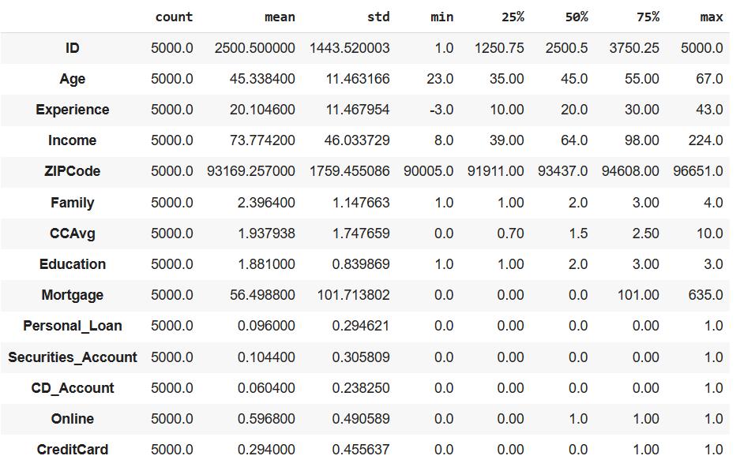
Data Overview
The statistical summary of the dataset for all data columns/variables is represented below.
Note:
Certain columns like Education are categorical columns but are represented as integers
Certains columns like Online , CreditCard etc are Boolean values represented as 1 and 0
Experience column has negative values which indicates errorneous data that will need to be corrected

Slide 7
Data Preprocessing
Preprocessing Checks | Actions Taken
Duplicate & Missing Value Checks | No duplicates or missing values detected
Anomalous Values | Experience variable had a few values that were negative. These negative values are assumed as data input errors and were corrected to be positive. Education variable values were represented with meaningful category labels instead of numeric values
Feature Engineering | Zip Code variable had 467 unique values across 5000 customer records. First two digits of ZIP Code were analyzed to be 7 unique values across the dataset Using the first two digits, Zip Code can be considered a “Category” Categorical features for following variables were encoded as “Category” Education Personal_Loan Securities_Account CD_Account Online CreditCard ZIPCode

Slide 8
Data Preprocessing
Preprocessing Checks | Actions Taken
Outlier Checks | Q1, Q3 and IQR was calculated to identify the lower and upper bounds and outliers in the data Table on the right summarizes the outliers for the numeric columns. As can be seen, there are no significant outliers
Data Preparation for Modeling | Before proceeding to build a model, we need to split the data into train, test and validation to be able to evaluate the model that we build on the training data Following steps were taken to prepare the data Separate independent and dependent variables Categorical features e.g Education and ZIP Code are encoded in dummy variables Dataset is split into train and test data for model development
Variable | # of Outliers | % of Outliers
Age | 0 | 0
Experience | 0 | 0
Income | 96 | 1.92
Family | 0 | 0
CCAvg | 324 | 6.48
Mortgage | 291 | 5.82
Shape of “Train” data set | (3500, 17)
Shape of “Test” data set | (1500, 17)
% of classes in “Train” data set | 0: 90.54% & 1: 9.46%
% of classes in “Test” data set | 0: 90.07% & 1: 9.93%

Slide 9
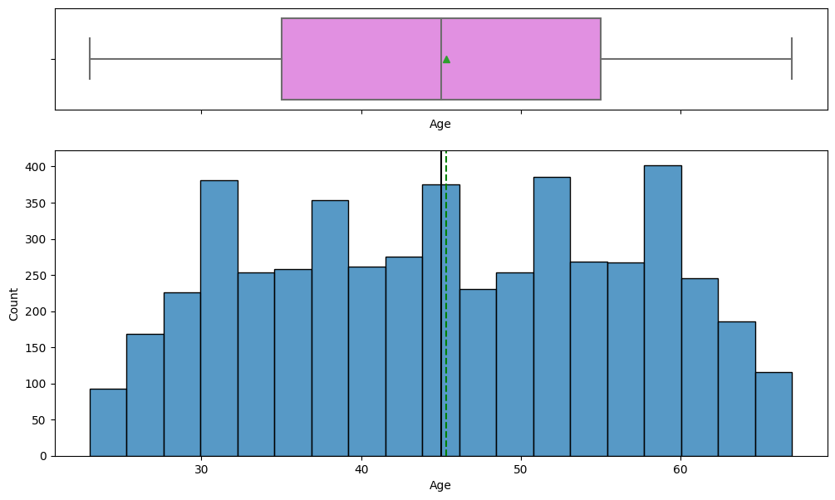
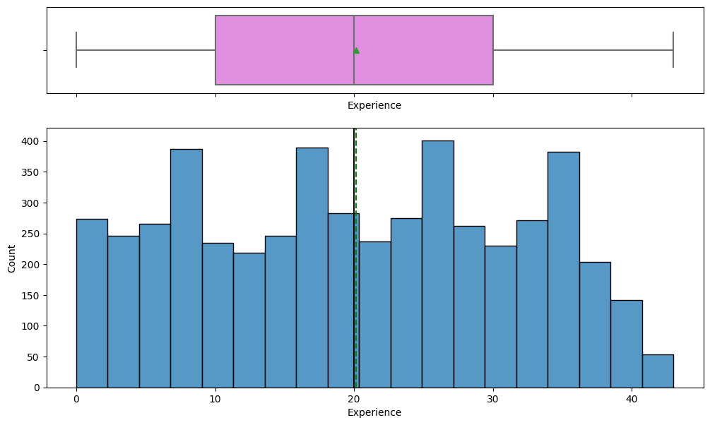
EDA Results – Univariate Analysis
Average age is about 45.33 years old.
The age distribution is uniform.
Average Experience is around 20.1 years.
Experience has a uniform distribution.
There are no outliers for both Age and Experience

Slide 10
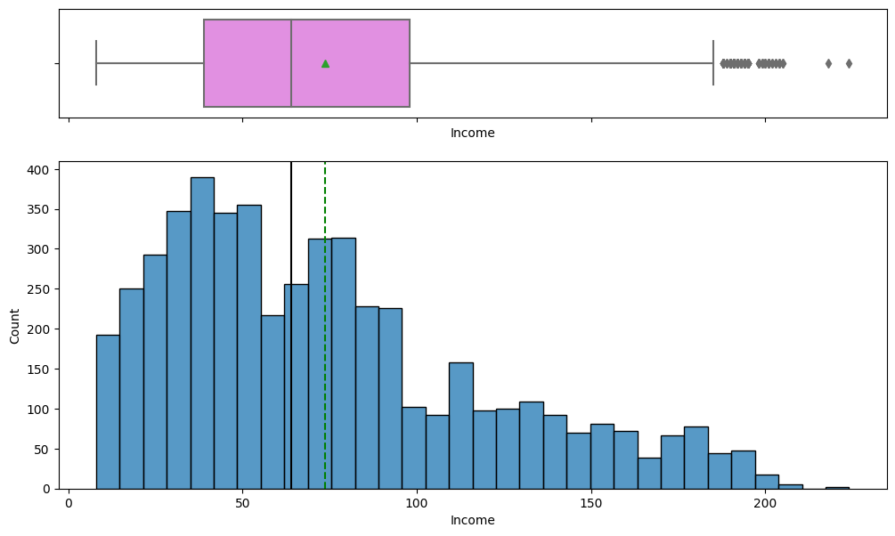
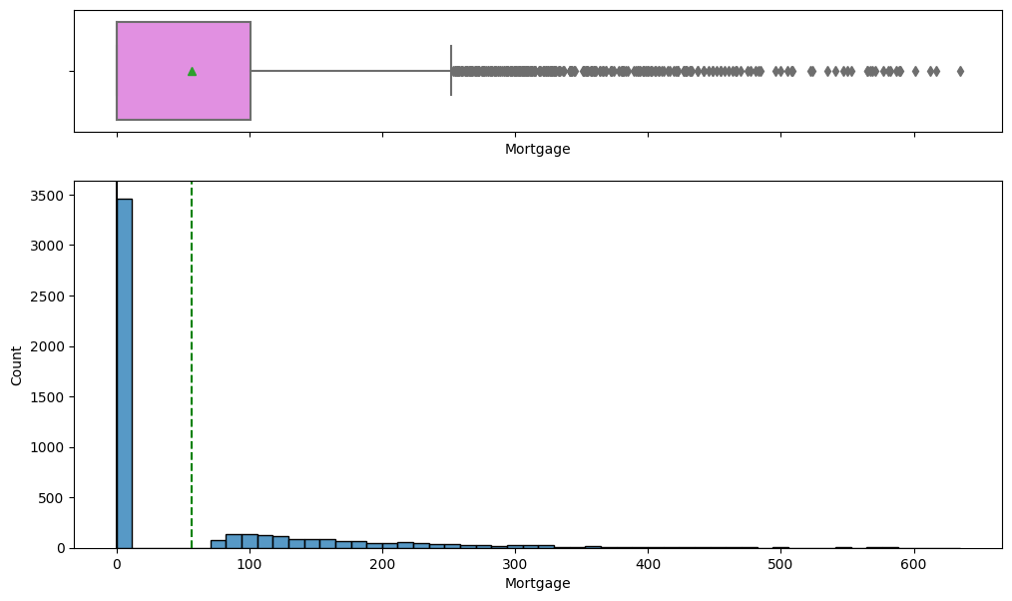
EDA Results – Univariate Analysis
Income is right skewed with many outliers on the higher side.
Average Income is $ 73.77K
Mortgage is right skewed with many outliers on the higher side.
Mortgage also has several “zero” values

Slide 11
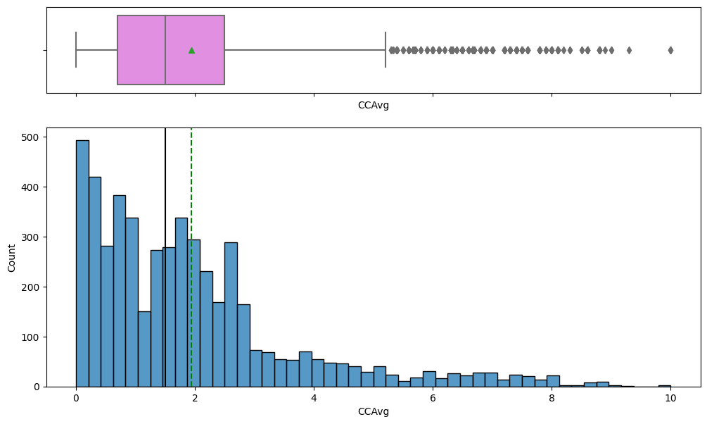
EDA Results – Univariate Analysis
CCavg is right skewed with many outliers on the higher side.
CCAvg has a mean value of $ 1.93K

Slide 12
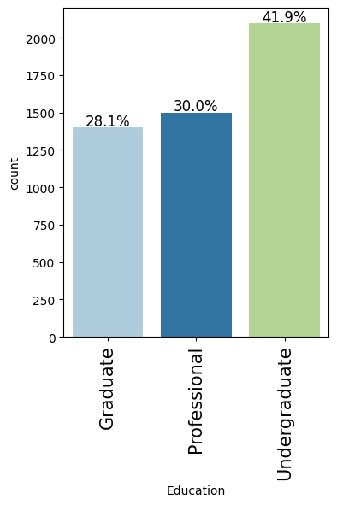
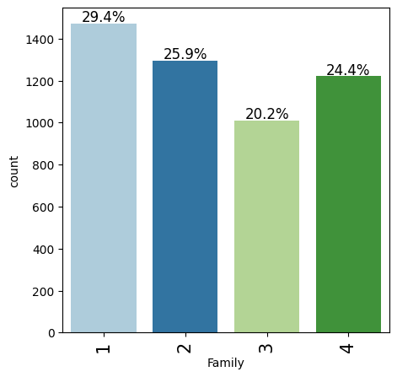
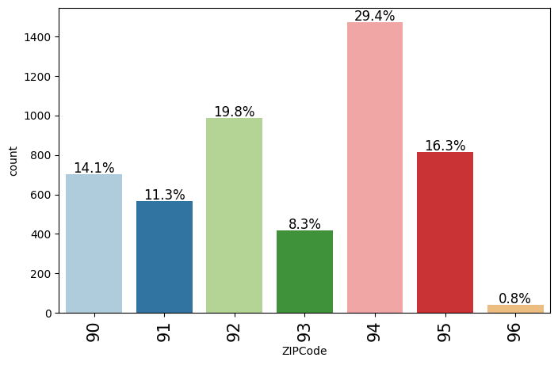
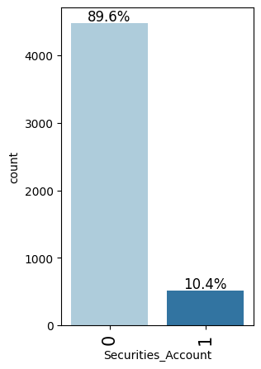
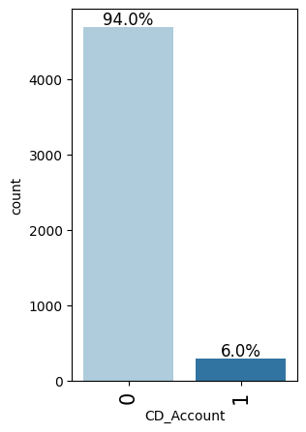
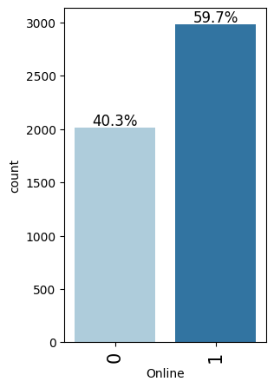
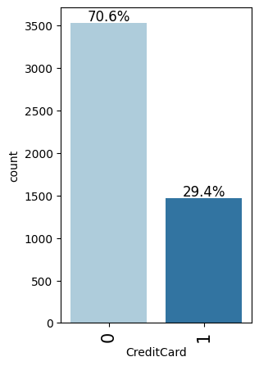
EDA Results – Univariate Analysis
Below charts are self explanatory and depict the distribution across the various values for the categorical variables

Slide 13
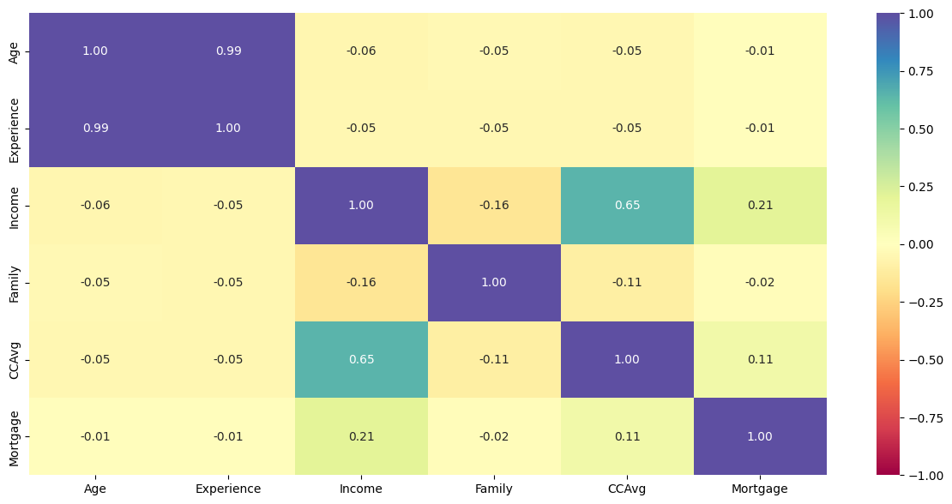
EDA Results – Bivariate Analysis
Age and Experience are very highly correlated
CCAvg has a high correlation with Income

Slide 14
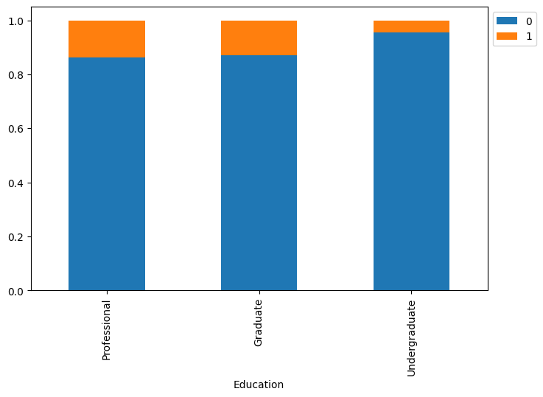
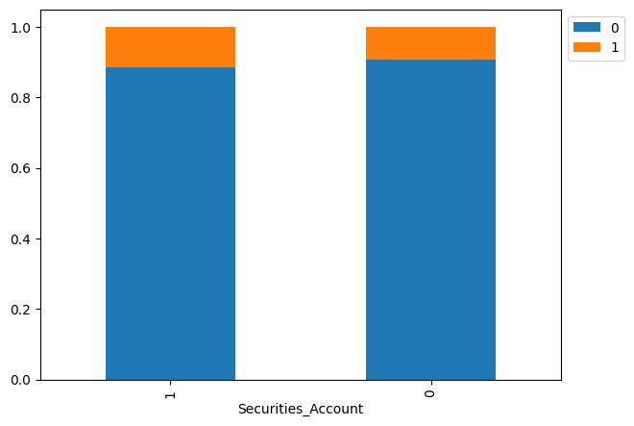
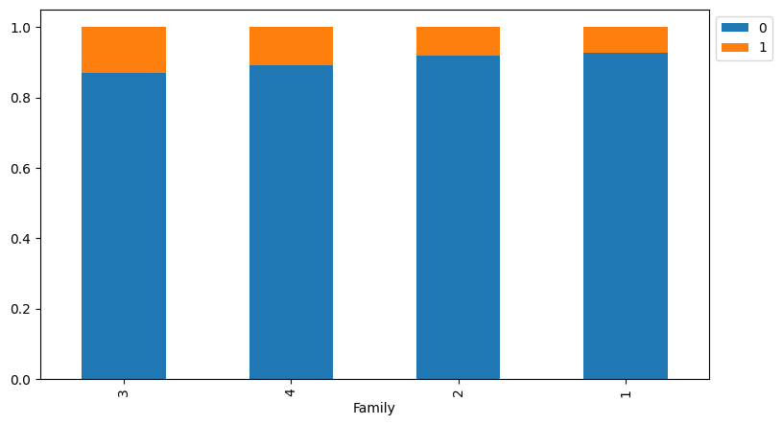
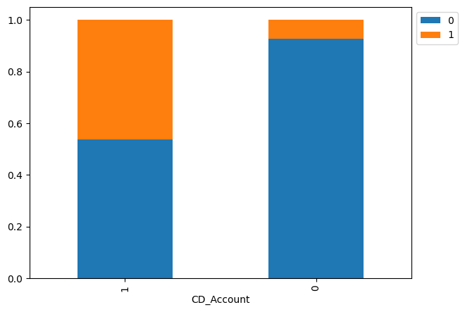
EDA Results – Bivariate Analysis
Customers with Professional and Graduate level of education have more Personal Loans than Undergraduates
Customers with family of 3 have higher number of loans than family of 4, followed by family of 2 and 1 respectively
Customers with Securities account have higher number of personal loans
Customers with CD accounts have a significantly higher number of personal loans

Slide 15
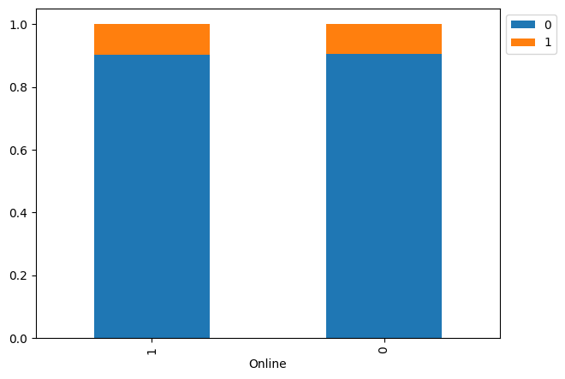
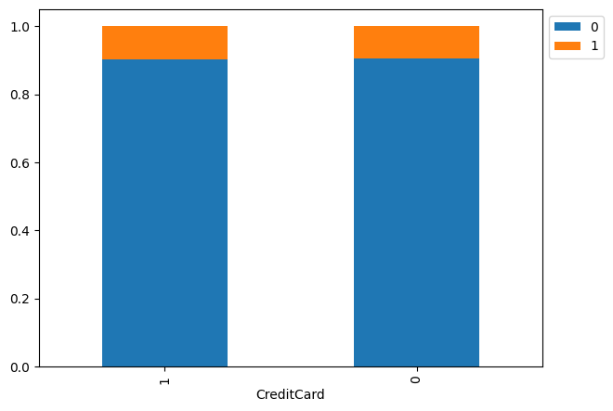
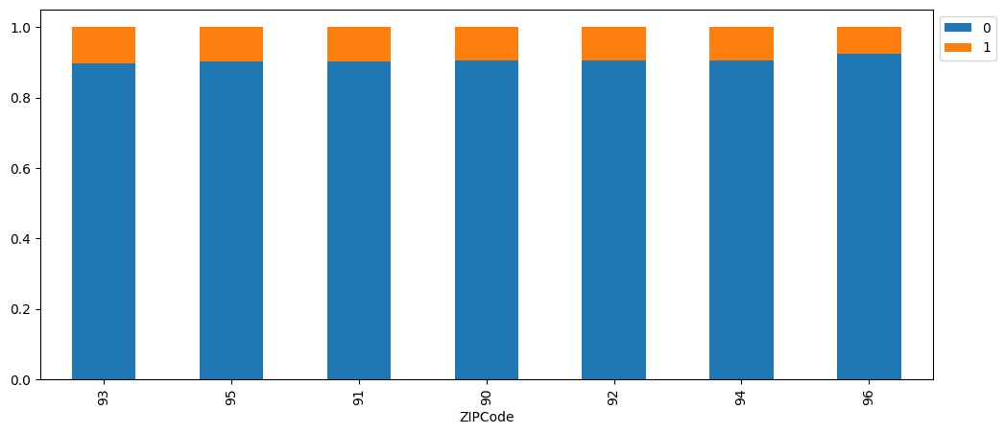
EDA Results – Bivariate Analysis
Customers that use Online and CreditCard have more personal loans
Customers that are within ZipCode starting with 94 have more personal loans
No other significant observations

Slide 16
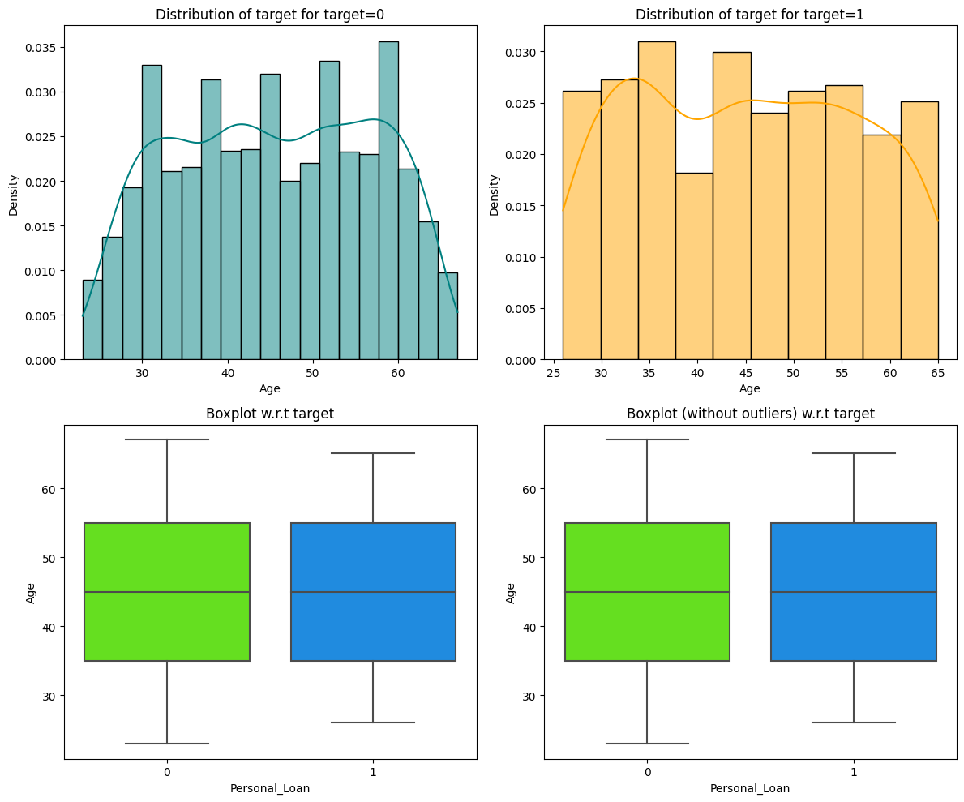
EDA Results – Bivariate Analysis
Customers with age between 26 and 65 have personal loans with highest distribution of loans around age 35 followed by age 45

Slide 17
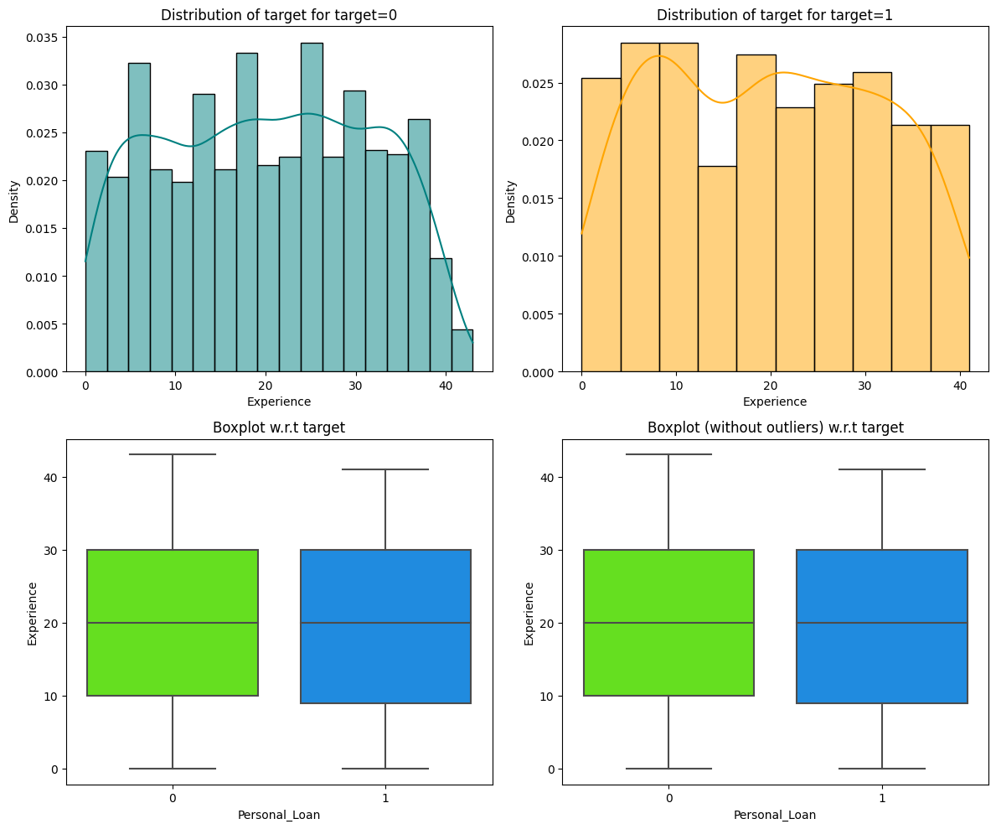
EDA Results – Bivariate Analysis
Highest personal loan distributions are in the experience group of 4 to 12 years

Slide 18
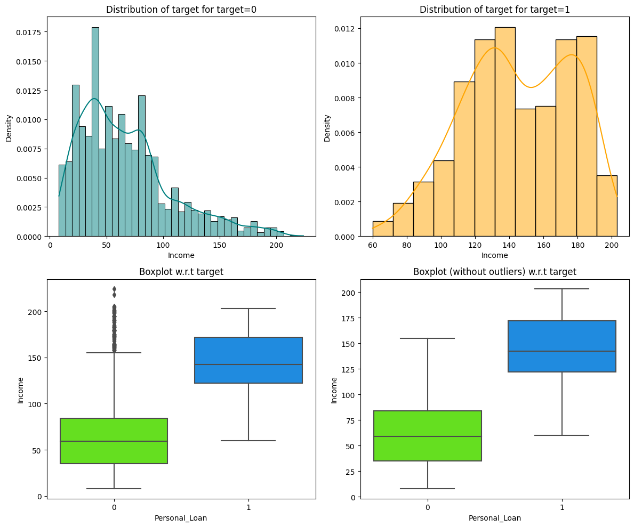
EDA Results – Bivariate Analysis
Customers with higher incomes have more personal loans

Slide 19
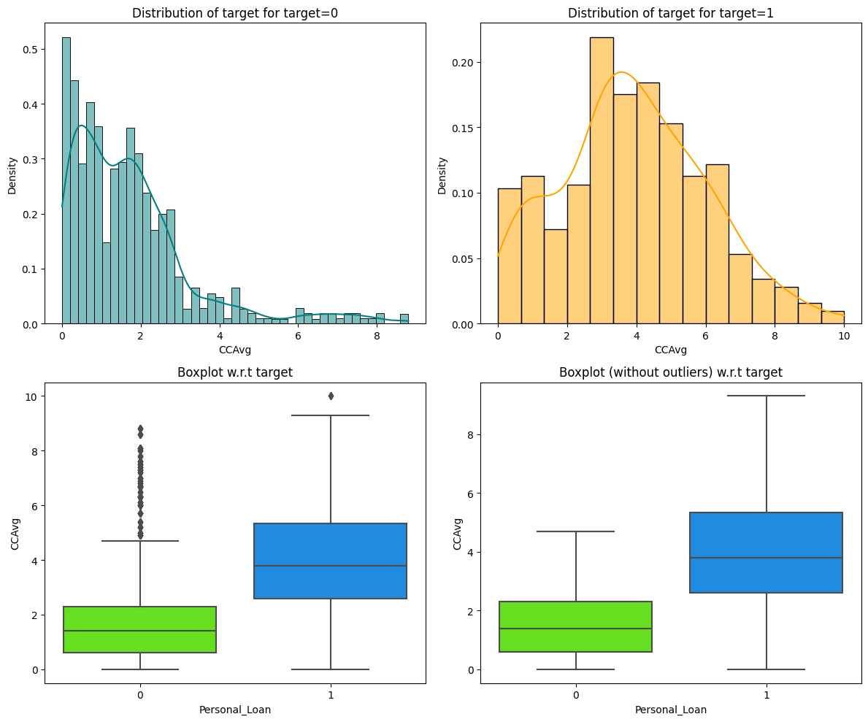
EDA Results – Bivariate Analysis
On average, those customers with higher credit card usage have personal loans

Slide 20
Model Performance Summary - Logistic Regression: Model Evaluation Criteria
Model can make wrong predictions as below:
False Positives (FP): Predicting a customer will take the personal loan but in reality the customer will not take the personal loan - Loss of resources
False Negatives (FN): Predicting a customer will not take the personal loan but in reality the customer was going to take the personal loan - Loss of opportunity
Which case is more important?
Losing a potential customer by predicting that the customer will not be taking the personal loan but in reality the customer was going to take the personal loan. Hence, False Negatives (FN) need to be minimized
How to reduce this loss of opportunity i.e need to reduce False Negatives?
Bank would want Recall to be maximized, Greater the Recall higher the chances of minimizing false negatives. Hence, the focus should be on increasing Recall or minimizing the false negatives.
Accuracy works best if false positives and false negatives have similar cost. If the cost of false positives and false negatives are very different, it’s better to look at both Precision and Recall.
F1 Score is a function of Precision and Recall and is a better measure to use if we need to seek a balance between Precision and Recall AND there is an uneven class distribution (large number of Actual Negatives).
Thus, our model performance evaluation will need to be based on - Recall and then on Precision and Recall vakues

Slide 21
Model Performance Summary – Logistic Regression
Leveraging on our model performance evaluation criterion to be based on – Recall and then on F1 Score and Precision values
ROC-AUC based regression approach provides the best Recall values of 0.882175 and 0.845638 for training and test data sets respectively. However, the precision values a significantly lower
Using the Threshold based on Precision-Recall curve balances out both Precision and Recall and provide the highest F1 scores 0.748092 and 0.770318 for training and test data sets respectively, amongst the 3 models
Thus the regression model that using optimal threshold based on Precision-Recall curve is recommended Logistic Regression model

Slide 22
Model Performance Summary – Decision Tree
Leveraging on our model performance evaluation criterion to be based on – Recall and then on F1 Score and Precision values
As you can see highlighted on the left, the Recall value on the test data set is the best with the Post Pruning Cost Complexity based model
Precision and F1 Score are also optimized on the test data set with the Cost Complexity based model
Thus the decision tree model based on Cost Complexity Pruning provides the best recall value
Following key variables that contribute to predicting target in order of importance –
Education_UnderGraduate
Income
Family
CCAvg
CD_Account
Age

Slide 23
APPENDIX

Slide 24
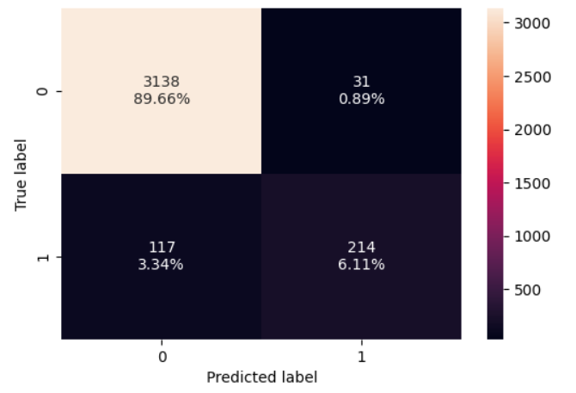
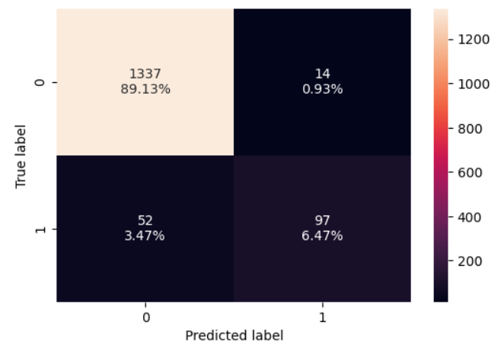
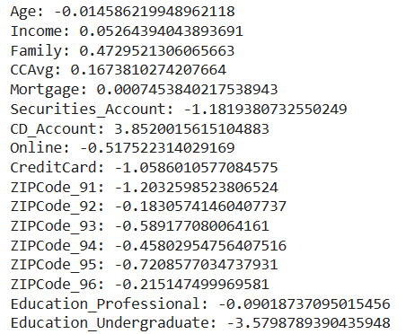
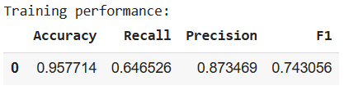
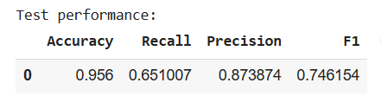
Model Building: Logistic Regression - Initial
Coefficients
Accuracy for training set and testing set was 0.9577 and 0.956 respectively
Recall values for both train and test data set are also comparable at 0.6465 and 0.6510. In fact test set gives a better Recall value.
Since our objective is to minimize False Negatives and maximize Recall we will try to optimize this model further and see if we can improve on Recall and Accuracy
Coefficients are also represented. The positive coefficient indicate a feature that predicts class 1, whereas the negative scores indicate a feature that predicts class 0. CD_Account, Family, CCAvg, Income, Mortgage have positive coefficient
Preliminary Logistic Regression on the training and the test data was conducted
Probability of classification labels is used to arrive at a threshold

Slide 25
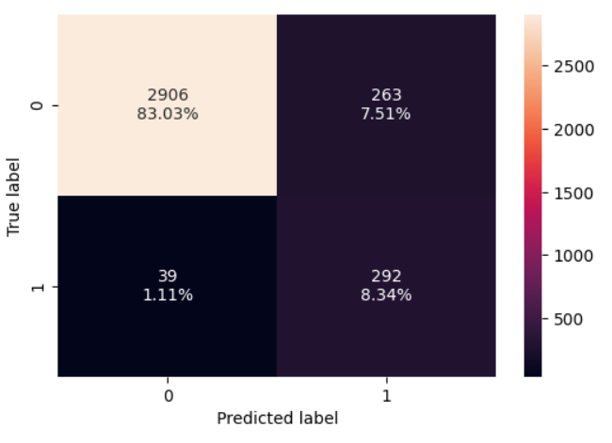
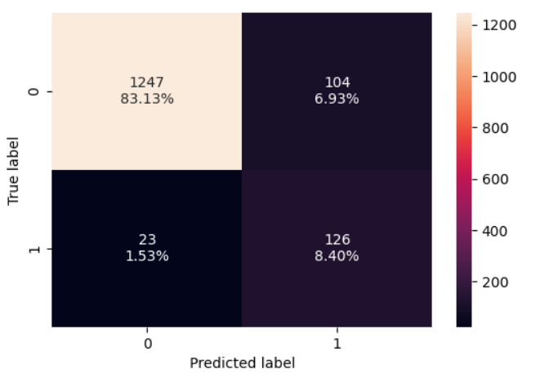
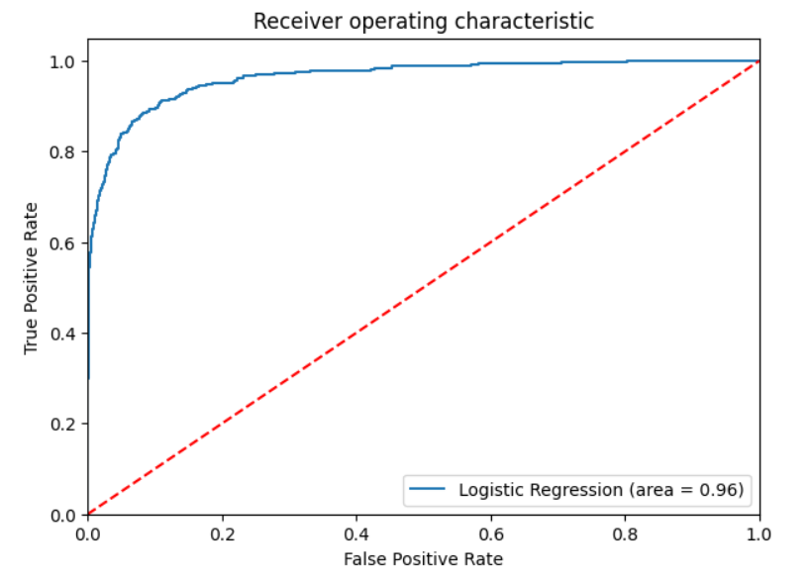
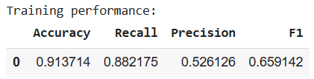
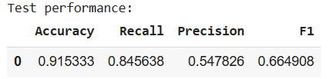
Model Performance Improvement: Logistic Regression : ROC-AUC Threshold
Logistic Regression is further optimized by calculating Optimal Threshold using ROC-AUC curve. ROC-AUC curve returns the FPR, TPR and Threshold values which takes the original data and predicted probabilities for the class 1. The optimal cut off would be where TPR is high and FPR is low
Optimal Threshold using ROC-AUC curve is 0.12589220403804577
With this approach
Accuracy for training set and testing set is now 0.9137 and 0.9153 respectively
Recall values for both train and test data set are now at 0.8821 and 0.8456.
As evident from the numbers although Accuracy has slightly decreased the Recall value has a sizeable jump due to the usage of optimal threshold from ROC-AUC curve
This model performance betters than the initial one. Next we can use the Precision-Recall Curve to see if we can optimize the model performance further

Slide 26
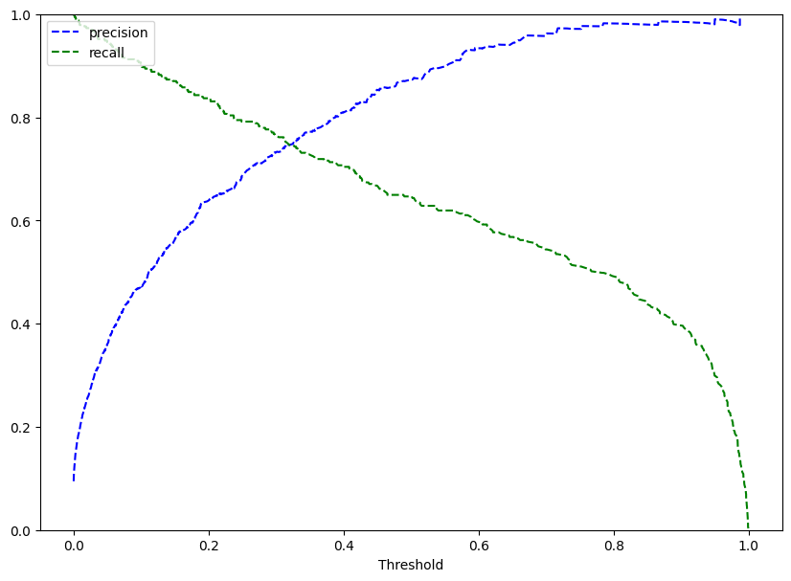




Model Performance Improvement: Logistic Regression : Precision-Recall Curve Threshold
Logistic Regression is further optimized by calculating Optimal Threshold using Precision-Recall curve. The Precision-Recall curve shows the tradeoff between Precision and Recall for different thresholds. It can be used to select optimal threshold as required to improve the model improvement.
Optimal Threshold using Precision-Recall curve is 0.33 (Observed from the curve above)
With this approach
Accuracy for training set and testing set is now 0.9529 and 0.9567 respectively
Recall values for both train and test data set are now at 0.7401 and 0.7315.
As evident from the numbers although Accuracy has now increased however the Recall value has slightly decreased

Slide 27
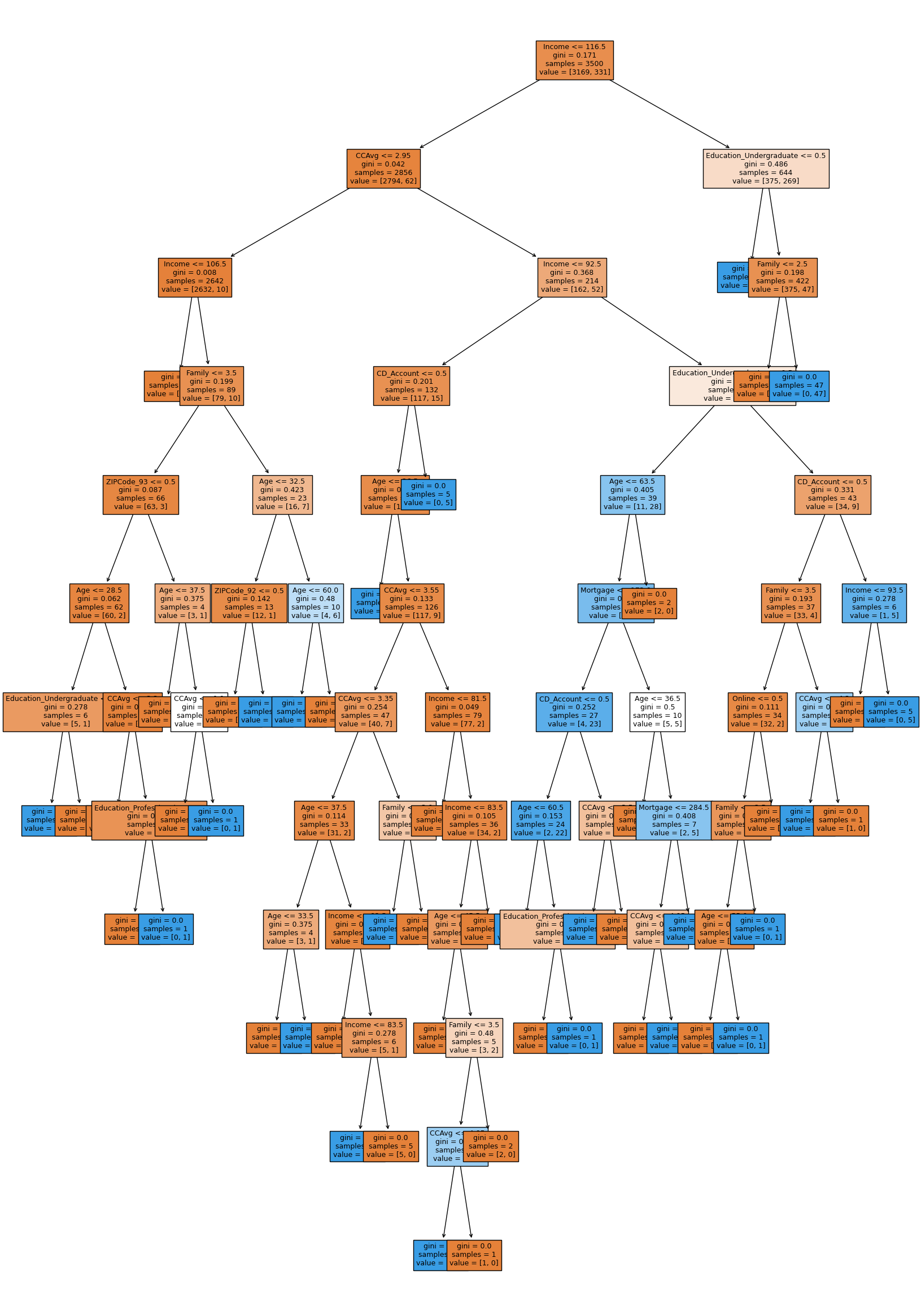
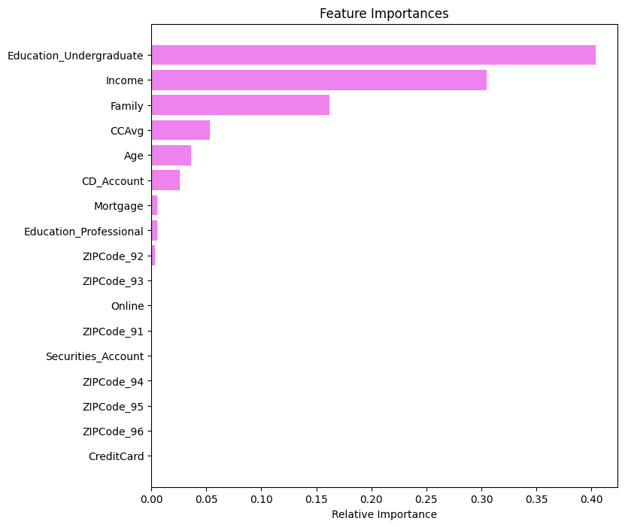
Model Building: Decision Tree - Initial
The initial model is built using DecisionTreeClassifier
We are going to be using the ‘gini’ impurity criteria
The goal is to find the best splits with the lowest possible Gini Impurity at every step.

Slide 28
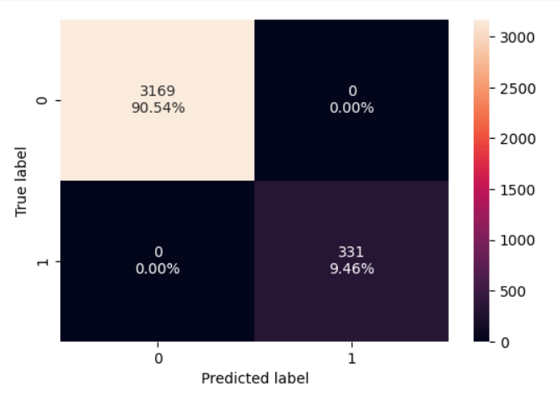
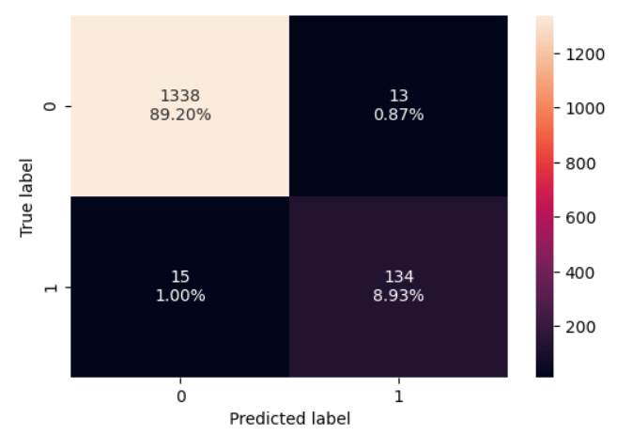
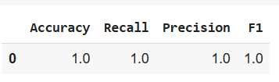

Model Building: Decision Tree - Initial
Training Performance
Testing Performance
Accuracy for training set and testing set was 1.0 and 0.981333 respectively
Recall values for both train and test data set are at 1.0 and 0.899329.
Based on the training results, it is very clear that the model is overfitting. This is also depicted by the decision tree visual on the prior slide
The Feature Importance chart represented on the prior slide indicates following key variables that contribute to predicting target in order of importance – Education_UnderGraduate, Income, Family, CCAvg, Age, CD_Account and a few others

Slide 29
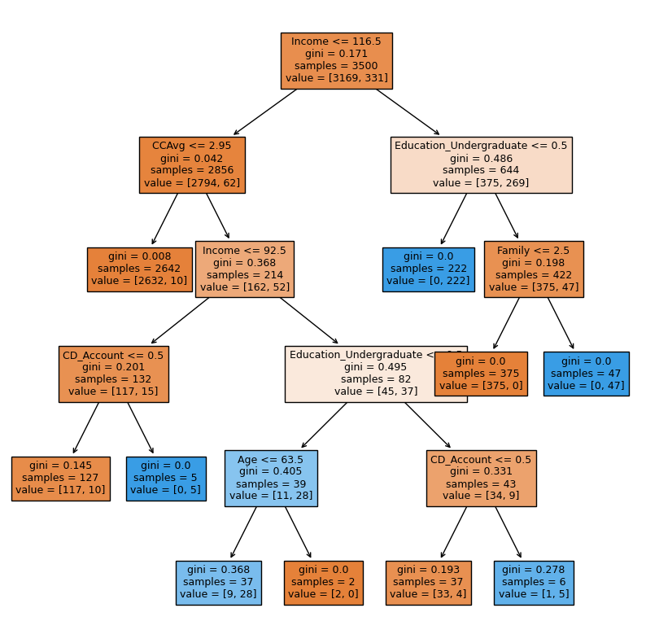
Model Performance Improvement: Decision Tree : Pre-Pruning
The improved model is built using DecisionTreeClassifier and pre-pruning techniques are used to avoid overfitting
Pre-Pruning is based on the following hyper parameters
max_depth: The maximum depth of the decision tree
min_samples_leaf: The minimum number of samples required to split a leaf node
max_leaf_nodes: The maximum number of leaf nodes in the decision tree
Hyper Parameter Values: max_depth key has values from 6 to 15. The min_samples_leaf key has a list with values 1, 2, 5, 7, and 10. The max_leaf_nodes key has a list with values 2, 3, 5, and 10.
The above dictionary of hyperparameters is used to train a decision tree model using a grid search.
A GridSearch Cross Validation is a technique that can be used to find the best hyperparameters for a model by evaluating the model with different combinations of hyperparameters.

Slide 30
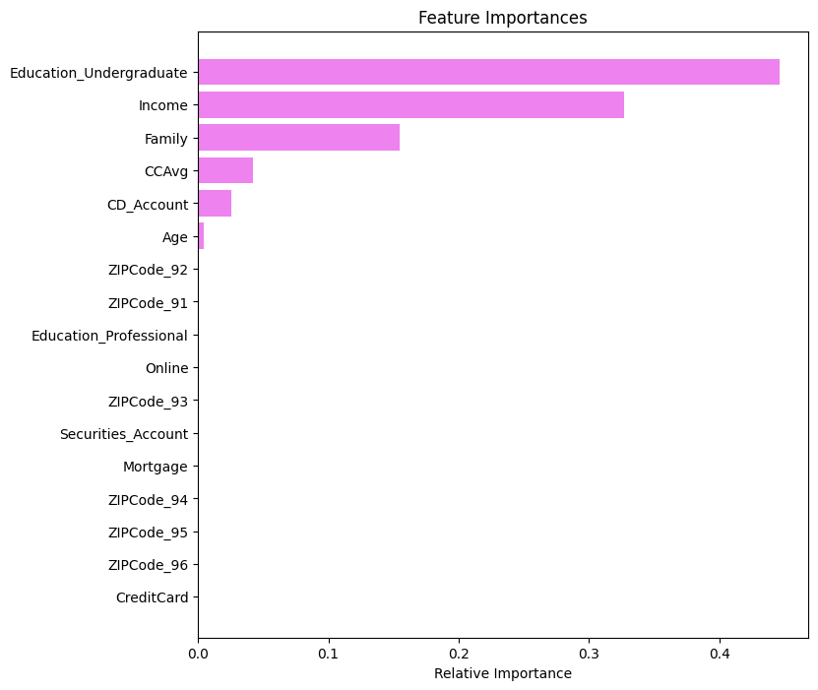
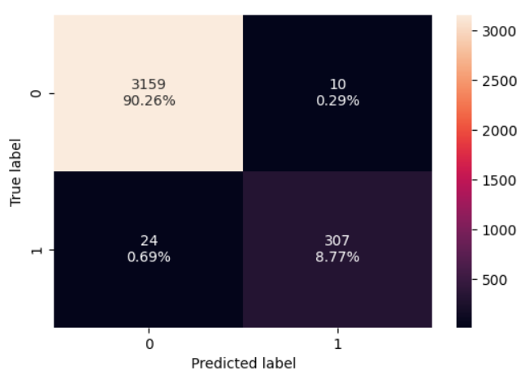
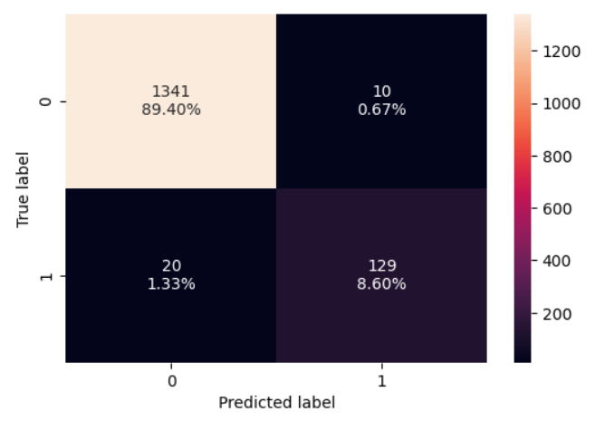
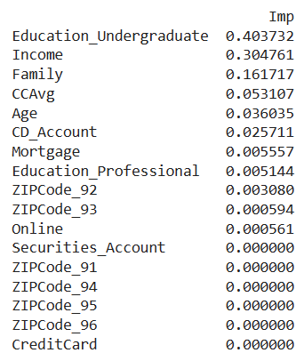


Model Performance Improvement: Decision Tree : Pre-Pruning
Training Performance
Testing Performance
Feature Importance
Accuracy for training set and testing set is now 0.990286 and 0.98 respectively
Recall values for both train and test data set are at 0.92 and 0.865772.
The Feature Importance chart represented above indicates following key variables that contribute to predicting target in order of importance – Education_UnderGraduate, Income, Family, CCAvg, CD_Account and Age

Slide 31
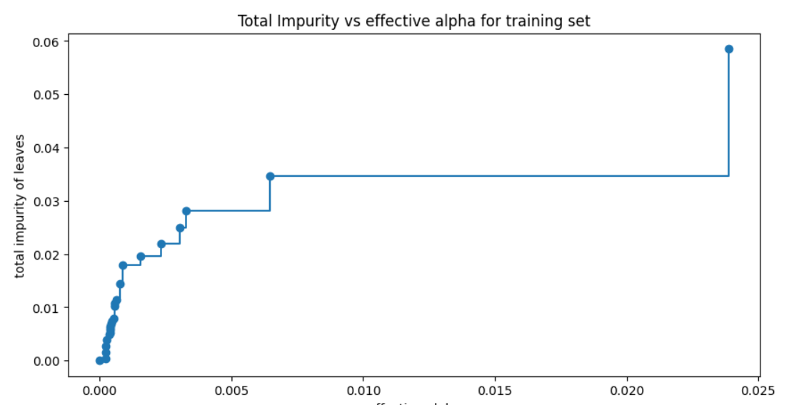
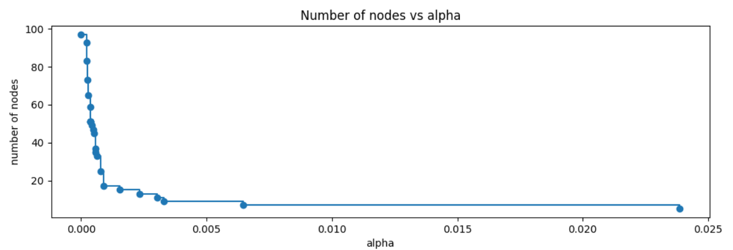
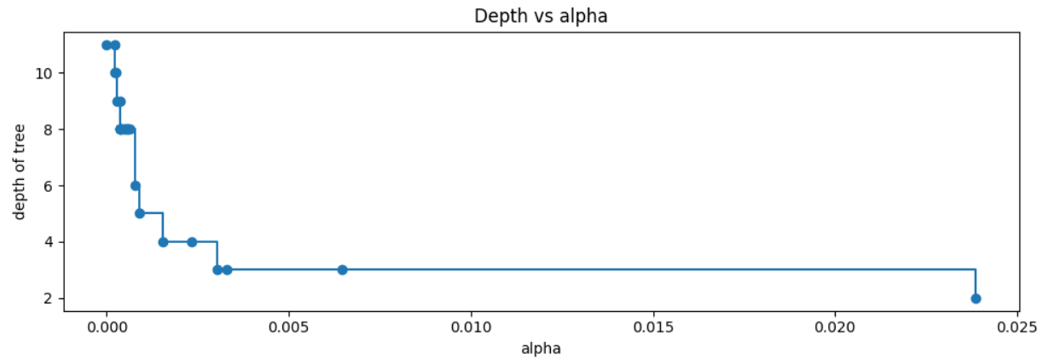
Model Performance Improvement: Decision Tree : Post-Pruning (Cost Complexity Pruning)
Figure B
Figure A
The improved model is built using DecisionTreeClassifier and post-pruning techniques leverage cost complexity pruning
Cost complexity pruning technique is used to reduce the size of a decision tree by removing nodes that do not contribute significantly to the model's performance.
We train the decision tree using effective alphas and try to find the best alpha
The higher the alpha value, the more nodes will be pruned from the tree. As alpha increases, the cost of nodes with higher depths becomes too high and they are pruned from the tree.
Figure C

Slide 32
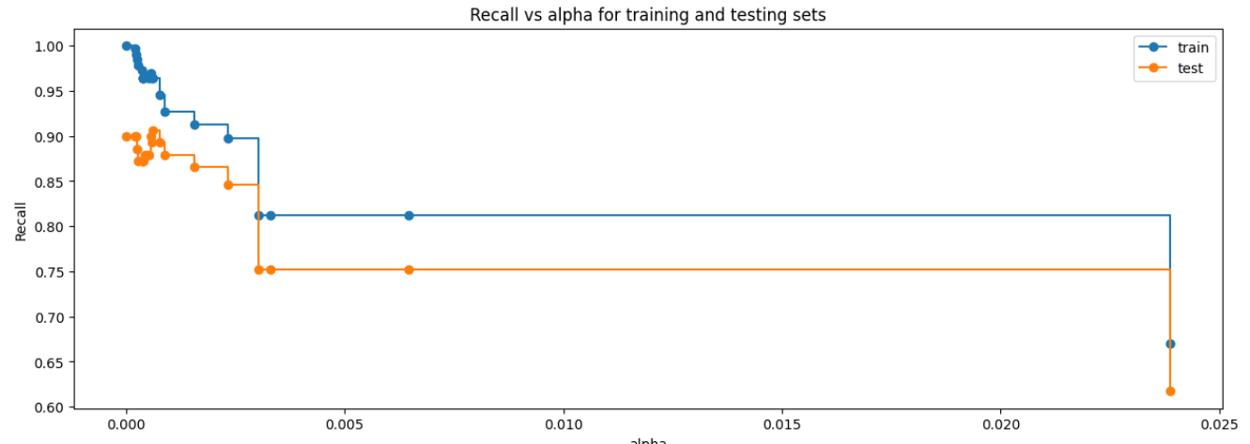
Model Performance Improvement: Decision Tree : Post-Pruning (Cost Complexity Pruning)
Best Fit Model is when
ccp_alpha=0.0006209286209286216

Slide 33

Model Performance Improvement: Decision Tree : Post-Pruning (Cost Complexity Pruning)

Slide 34





Model Performance Improvement: Decision Tree : Post-Pruning (Cost Complexity Pruning)
Accuracy for training set and testing set is now 0.993143 and 0.984 respectively. Better than the prior model
Recall values for both train and test data set are at 0.963746 and 0.90604
F1 Score is also optimized at 0.963746 and 0.918367 for train and test data
The Feature Importance chart represented above indicates following key variables that contribute to predicting target in order of importance – Education_UnderGraduate, Income, Family, CCAvg, CD_Account and Age
These are the most optimized values

